Slide 1
Pandas

Slide 2
Pandas
Pandas is a Python library used for working with data sets.
It has functions for analyzing, cleaning, exploring, and manipulating data.
Notes:
Library – pre-written code to help solve problems

Slide 3
Why Use Pandas?
Pandas allows us to analyze big data and make conclusions based on statistical theories.
Pandas can clean messy data sets, and make them readable and relevant.
Relevant data is very important in data science.

Slide 4
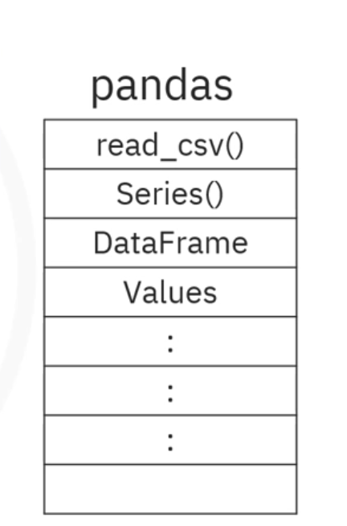
What Can Pandas Do?
Pandas gives you answers about the data. Like:
Is there a correlation between two or more columns?
What is average value?
Max value?
Min value?
Pandas are also able to delete rows that are not relevant, or contains wrong values, like empty or NULL values. This is called cleaning the data.

Slide 5
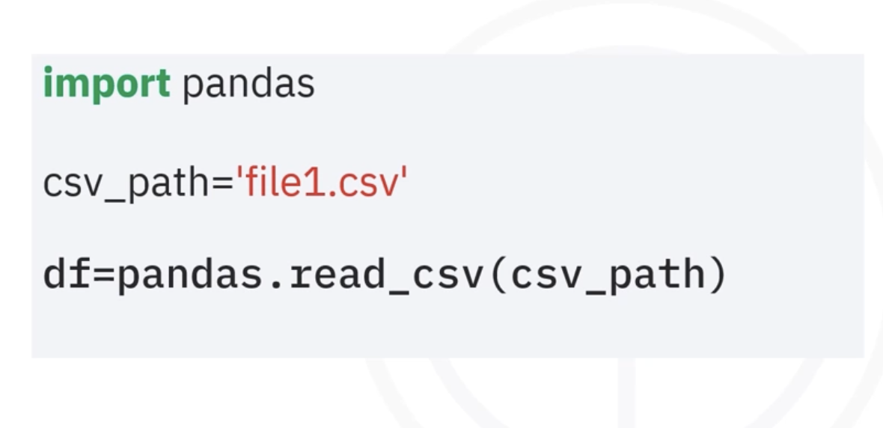
CSV, Excel files converted to dataframe

Slide 6
Pandas Data Structures
Data Structures: Pandas offers two primary data structures
DataFrame and Series

Slide 7
Pandas DataFrames
A Pandas DataFrame is a 2 dimensional data structure, like a 2 dimensional array, or a table with rows and columns.
Pandas DataFrame is a two-dimensional, size-mutable, and heterogeneous data structure (similar to a table in a relational database or an Excel spreadsheet).

Slide 8
Pandas DataFrames
Example:
Create a simple Pandas DataFrame:
import pandas as pd //Importing pandas library data = { ’calories’: [420, 380, 390], ’duration’: [50, 40, 45] } #load data into a DataFrame object: df = pd.DataFrame(data) print(df)
Keys correspond to columns and values respond to rows
Creating a dataframe out of a dictionary
 | Calories | Duration
0 | 420 | 50
1 | 380 | 40
2 | 390 | 45

Slide 9
Example
import pandas as pd mydataset = { 'cars': ["BMW", "Volvo", "Ford"], 'passings': [3, 7, 2] } myvar = pd.DataFrame(mydataset) print(myvar)
 | Cars | Passings
0 | BMW | 3
1 | Volvo | 7
2 | Ford | 2
Notes:
mydataset = {'cars': ["BMW", "Volvo", "Ford"],'passings': [3, 7, 2]}
myvar = pd.DataFrame(mydataset)
print(myvar)

Slide 10
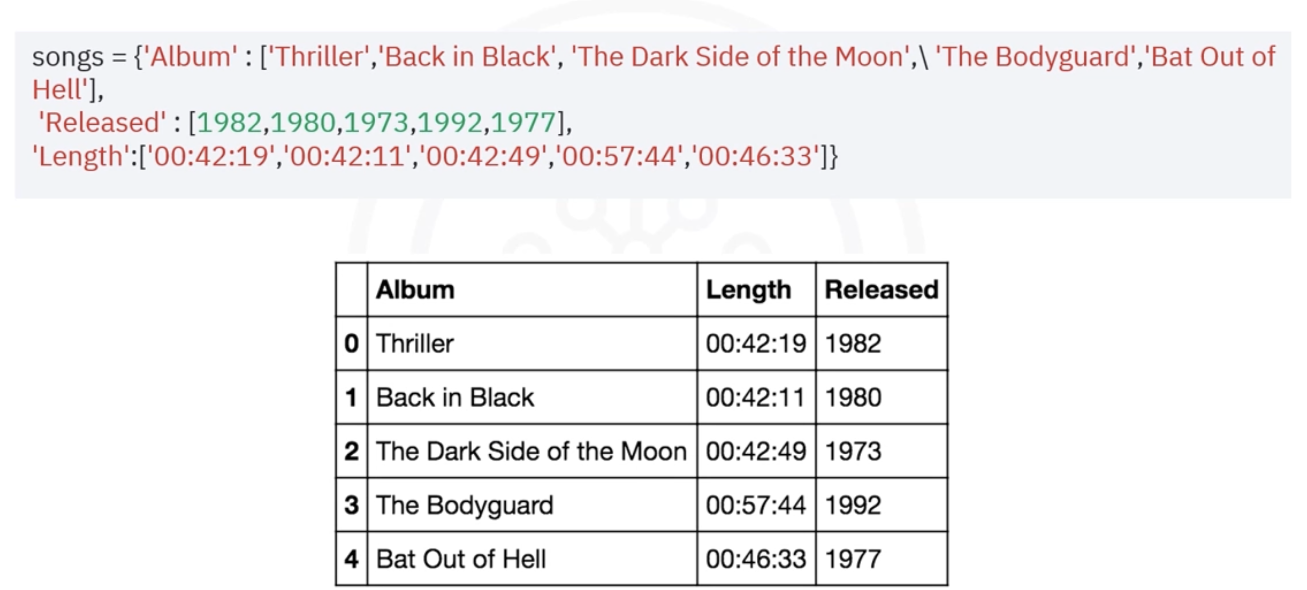

Slide 11
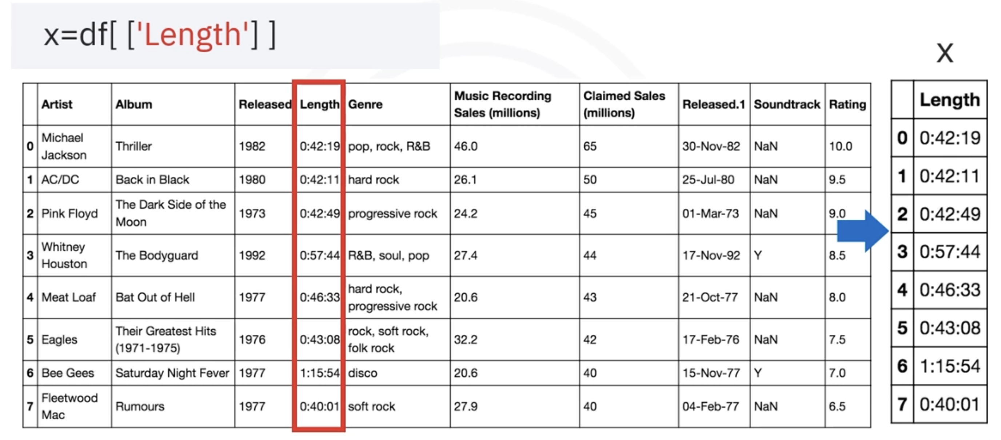
Dataframe with one column
X = df[[‘Length’]]

Slide 12
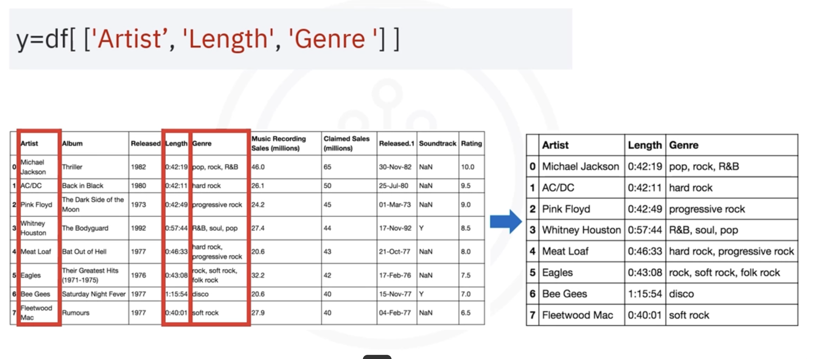
Dataframe with multiple columns

Slide 13
Pandas DataFrames
df.head() – First five rows of the dataframe
df.tail() - View the last n rows of the DataFrame (default is 5 rows).
df.info(): This method provides a concise summary of the DataFrame, including the number of non-null entries, column names, and data types.
df.describe(): Returns description of the data in the DataFrame.
count - The number of not-empty values. mean - The average (mean) value. std - The standard deviation. min - the minimum value. 25% - The 25% percentile*. 50% - The 50% percentile*. 75% - The 75% percentile*. max - the maximum value.

Slide 14
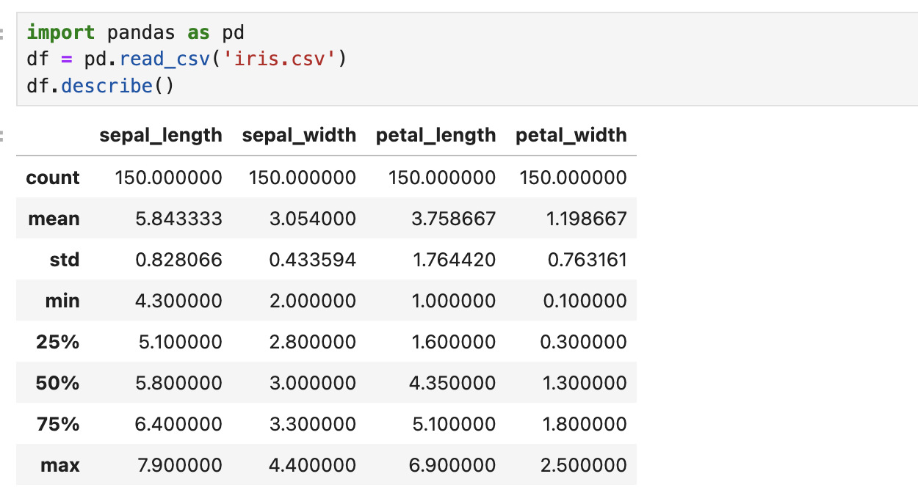

Slide 15
Pandas DataFrames
Locate Row:
As you can see from the result above, the DataFrame is like a table with rows and columns.
Pandas use the loc attribute to return one or more specified row(s)

Slide 16
Pandas DataFrames
Example
Return row 0:
#refer to the row index: print(df.loc[0])

Slide 17
Pandas Series
A one-dimensional labeled array, essentially a single column or row of data.
A Pandas Series is like a column in a table.
It is a one-dimensional array holding data of any type.
Example:
Create a simple Pandas Series from a list:
import pandas as pd a = [1, 7, 2] data1 = pd.Series(a) print(data1)

Slide 18
Labels
If nothing else is specified, the values are labeled with their index number. First value has index 0, second value has index 1 etc.
This label can be used to access a specified value.
With the index argument, you can name your own labels.

Slide 19
Labels
Example
Create your own labels:
import pandas as pd a = [1, 7, 2] myvar = pd.Series(a, index = ["x", "y", "z"]) print(myvar)
 | myVar
x | 1
y | 7
z | 2

Slide 20
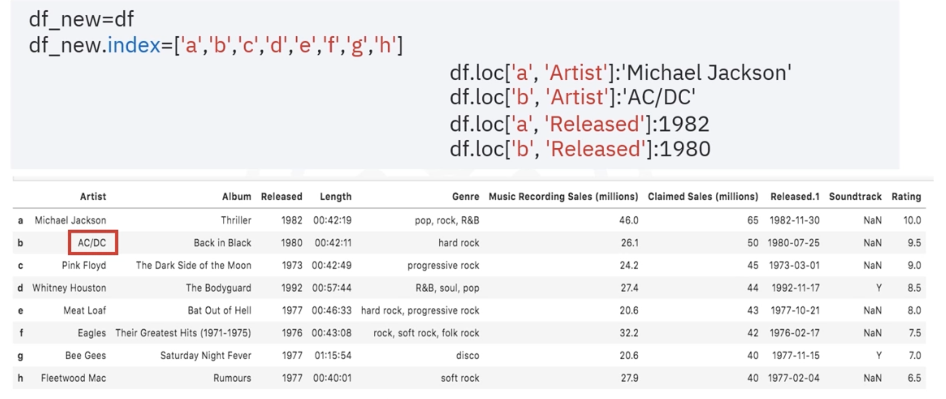
Df.loc[‘b’:’e’, ‘Artist’]

Slide 21
Navigating DataFrame – loc and iloc
Both used for accessing rows and columns in dataframe
Label-based Indexing (loc)
Access rows and columns by their labels
Includes both the start and end positions in slicing
df.loc[row_labels, column_labels]
Integer location-based Indexing (iloc)
Access rows and columns by their integer positions
Excludes end positions in slicing
Does not accept Boolean data
df.iloc[row_labels, column_labels]
df.loc[1, 'column_name'] # Accesses the row with label 1 and column 'column_name'
df.loc[1:3, 'col1':'col3'] # Accesses rows 1 to 3 and columns 'col1' to 'col3'
df.iloc[1, 0] # Accesses the second row (index 1) and first column (index 0)
df.iloc[1:3, 0:2] # Accesses rows at index 1 and 2, and columns at index 0 and 1

Slide 22
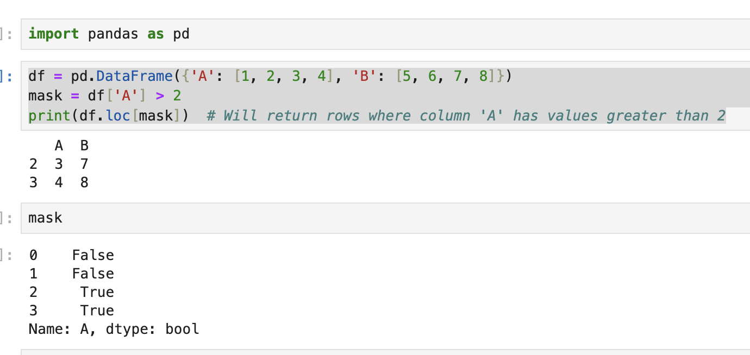

Slide 23
Navigating Data Frame
iloc exclusively uses integer positions for accessing data.
As a result, it makes it particularly useful when dealing with data where labels might be unknown or irrelevant.
df.iloc[row number/slice]
df.iloc[4], df.iloc[1:4], df.iloc[:],
df.iloc[1:4, 5:8] --- SLICING

Slide 24
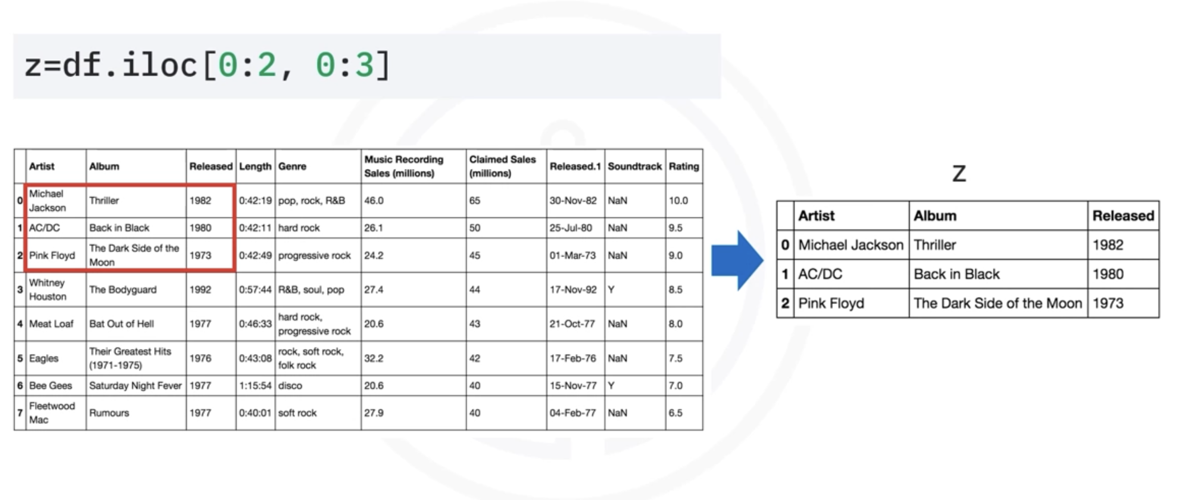
Dataframe Slicing

Slide 25
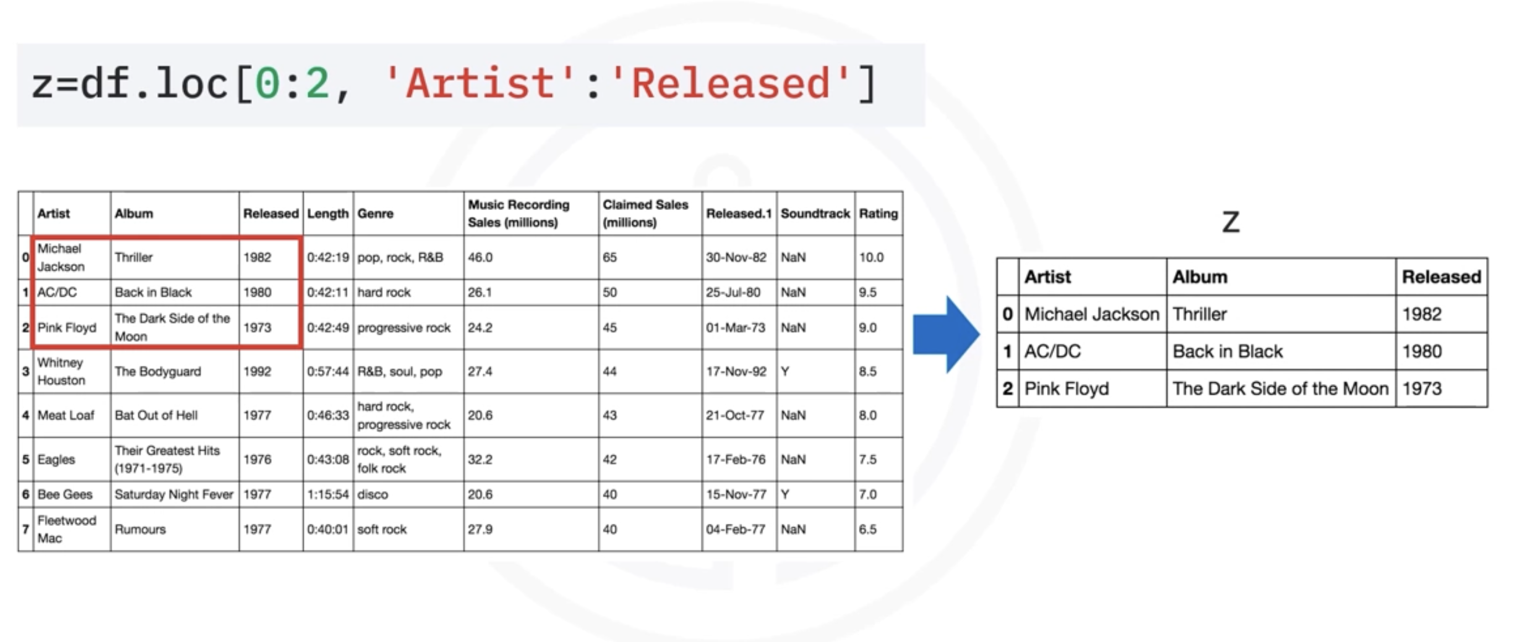
Dataframe Slicing

Slide 26
Navigating Data Frame
df.iloc[4]-This command selects the 5th row (index 4) from the DataFrame df. It returns a single row as a Series.
df.iloc[1:4]:This command selects a slice of rows from index 1 to 3 (excluding index 4) from df. It returns multiple rows as a DataFrame.

Slide 27
Navigating Data Frame
df.iloc[:]
-This command selects all rows and columns from df. It’s essentially the same as df, returning the entire DataFrame.
df.iloc[1:4, 5:8]:This command selects rows from index 1 to 3 (excluding 4) and columns from index 5 to 7 (excluding 8). It returns the specified subset as a DataFrame.

Slide 28
Navigating Data Frame
df.iloc[:,2]-This will select all rows (:) for the specified column index (3rd column), effectively giving you the entire column without specifically extracting any single row.
This is the closest way to extract a column with .iloc without targeting individual rows.

Slide 29
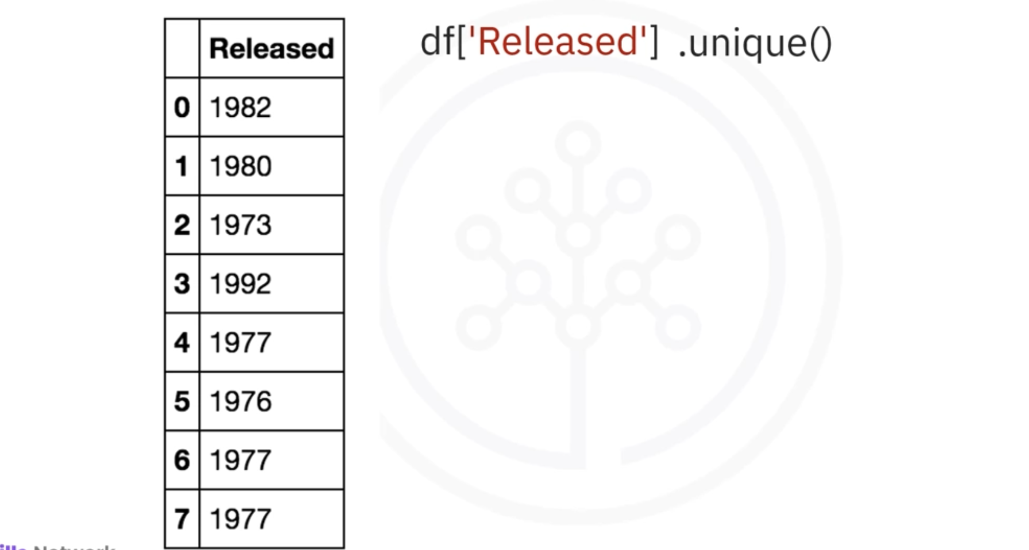
Listing Unique Values

Slide 30
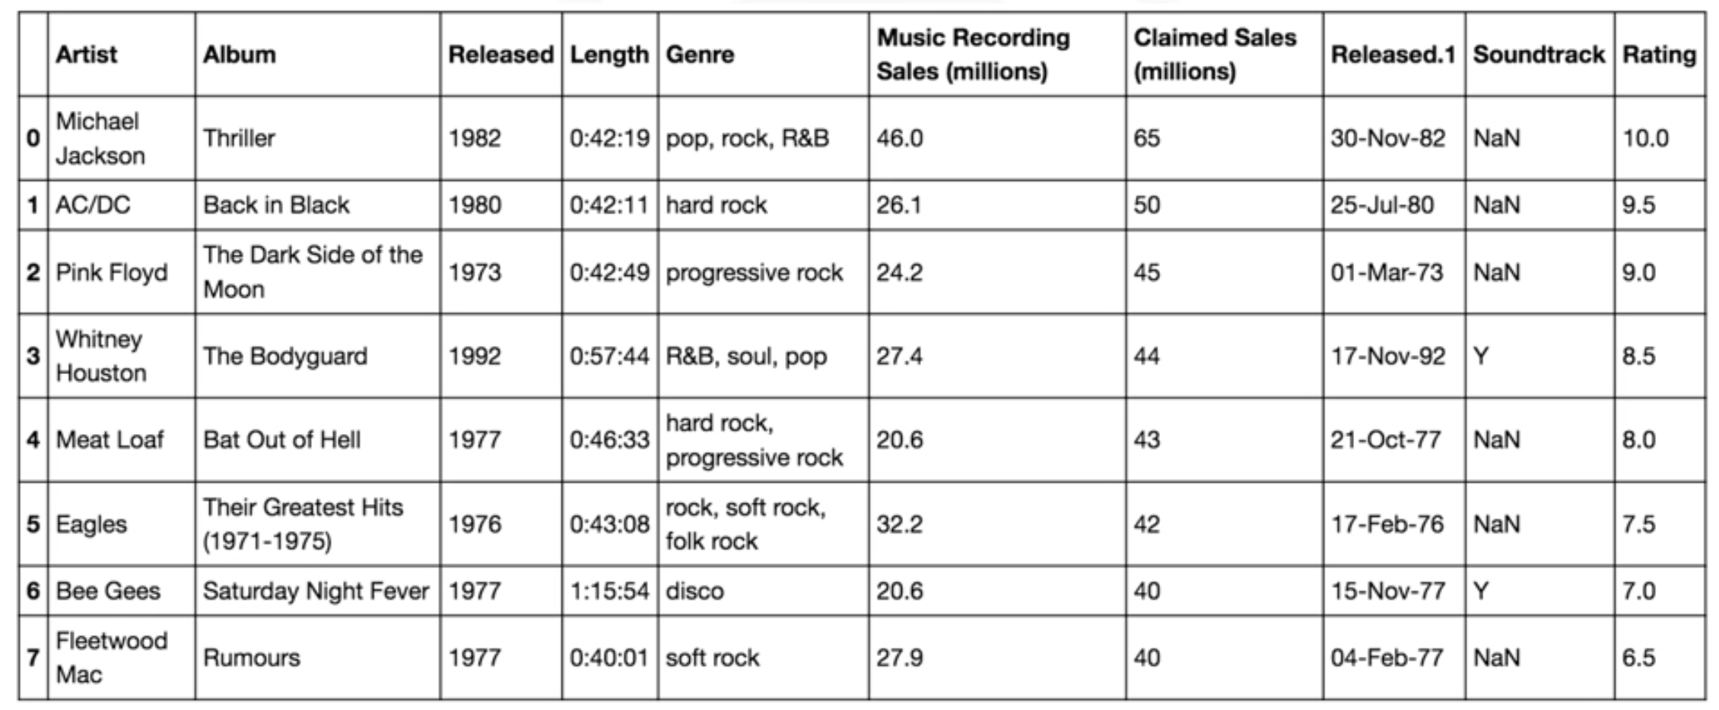
create a new database consisting of songs from the 1980s and after

Slide 31
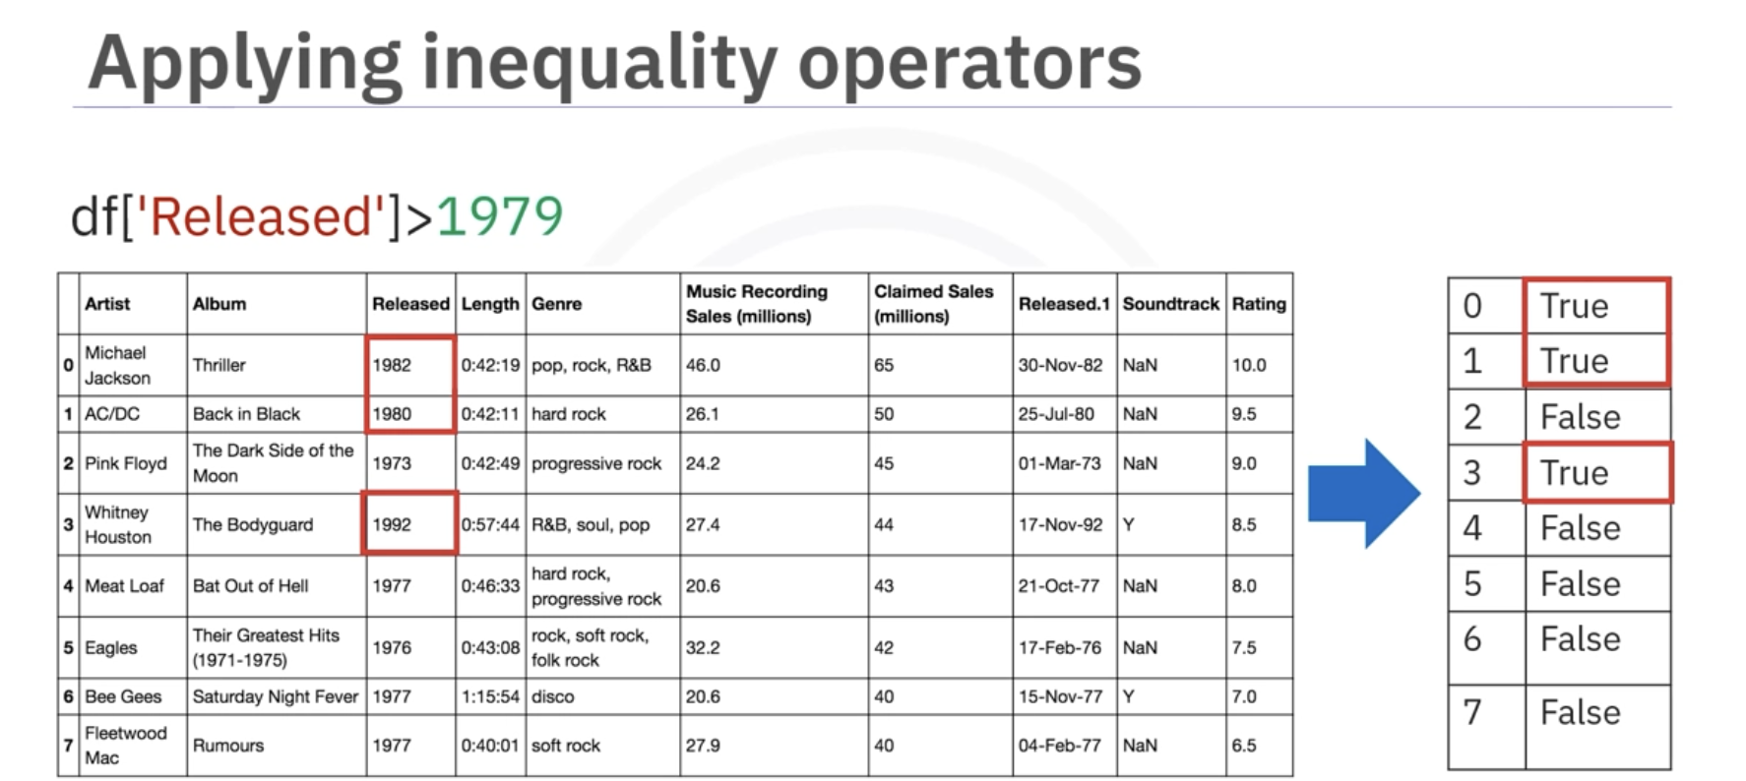

Slide 32
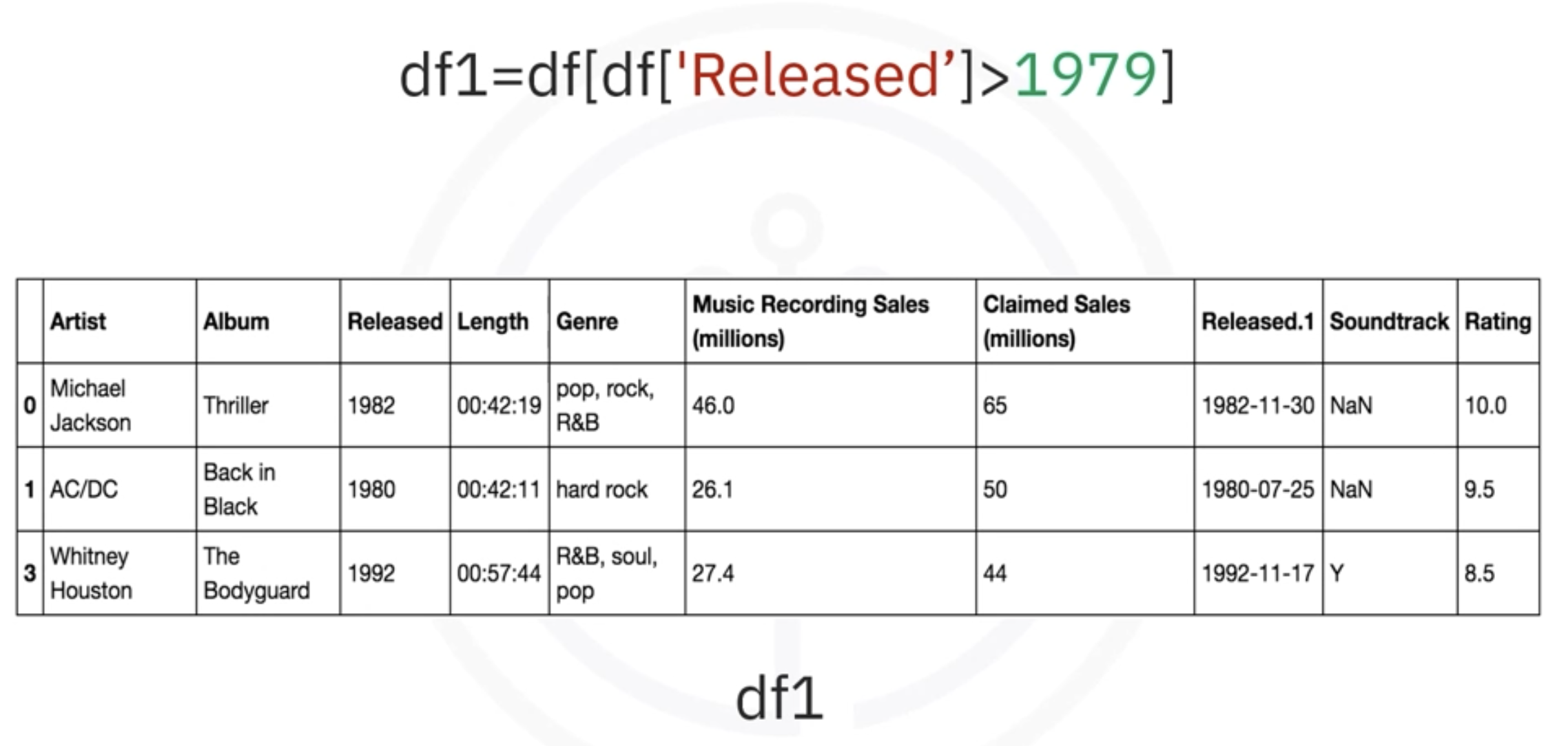
When you use the Boolean Series as an index (e.g., df[boolean_series]), pandas returns a new DataFrame containing only the rows where the Boolean Series has True values.

Slide 33
Pandas Read CSV
A simple way to store big data sets is to use CSV files (comma separated files).
CSV files contains plain text and is a well know format that can be read by everyone including Pandas.
In our examples we will be using a CSV file called 'data.csv'.

Slide 34
Pandas Read CSV
Example:
Load the CSV into a DataFrame:
import pandas as pd df = pd.read_csv('data.csv’) df.head() #show only first 5 rows print(df.to_string()) #show all the rows

Slide 35
Pandas Read CSV
The pd.read_csv() function is used to read the data from the data.csv file.
df.to_string() converts the entire DataFrame df into a string representation, showing all rows and columns.
If you have a large DataFrame with many rows, Pandas will only return the first 5 rows, and the last 5 rows:

Slide 36
Delete a column from Dataset
You can delete a column or feature from a dataset-
df.drop(labels, axis, index, columns, inplace)
Axis = Whether to drop labels from the index (0 or ‘index’) or columns (1 or ‘columns’)
Labels = Index or column labels to drop
df.drop(labels, axis, index, columns, inplace)
Index = labels
Column = labels
Method 2
Dropping both
Method 1
Dropping either

Slide 37
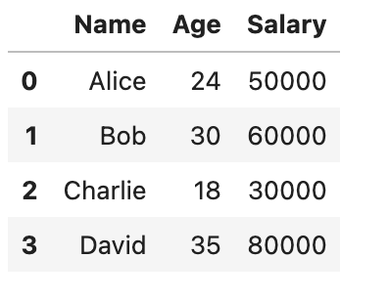
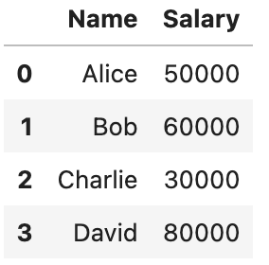
df.drop(labels=[‘Age’], axis=1, inplace=True)

Slide 38
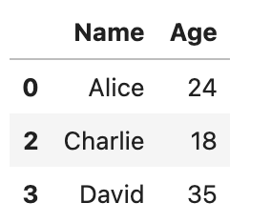
df.drop(index=[1], columns=['Salary'], inplace=True)

Slide 39
Delete a column from Dataset
df.drop(df.columns[1], axis=1, inplace=True)
Column Selection: df.columns[1] is used to select the second column.
Axis Parameter: axis=1 specifies you are dropping a column. For rows, use axis=0.
Inplace=True - If you want to modify the DataFrame in place.
Inplace=False- If you do not want to modify the DataFrame in place

Slide 40
Delete a row from Dataset
You can delete a row or feature from a dataset-
df.drop(1, axis=0, inplace=True)
Row Selection: The first parameter ‘1’ is used to select the first row.
Axis Parameter: axis=0 specifies you are dropping a row.
Inplace=True - If you want to modify the DataFrame in place.
Inplace=False- If you do not want to modify the DataFrame in place

